Slide 1

Credit Card Fraud Detection
Anomaly Detection with Autoencoder (Keras)
6th July 2021
Mingxi Li

Slide 2

Contents
1. Problem Description & Data Exploration
3. Training Data Preparation
5. Anomaly Detection
4. Model Building
2. Project Structure

Slide 3
Problem Description & Data Exploration
1

Slide 4
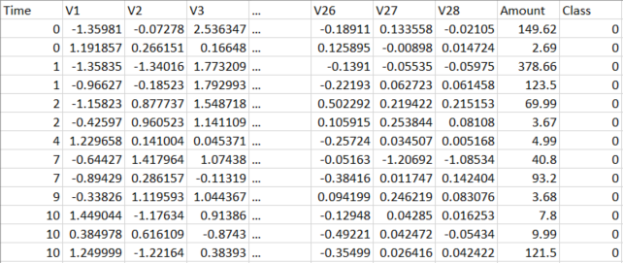
Target:
Using unsupervised anomaly detection technique to recognize fraudulent credit card transactions so that customers are not charged for item that they did not purchase.
Dataset:
The dataset contains 2 days transection records made by credit cards in September 2013 by EU cardholders.
Besides ‘Time’, ‘Amount’ and ‘Class’, the dataset only contains numerical input variables which are the result of a PCA transformation (V1 ~ V28).
‘Time’ is the seconds elapsed between each transaction and the first transaction in the dataset, so the time range is [0, 172792].
‘Class’ is the response variable and it takes value 1 in case of fraud and 0 otherwise.

Slide 5
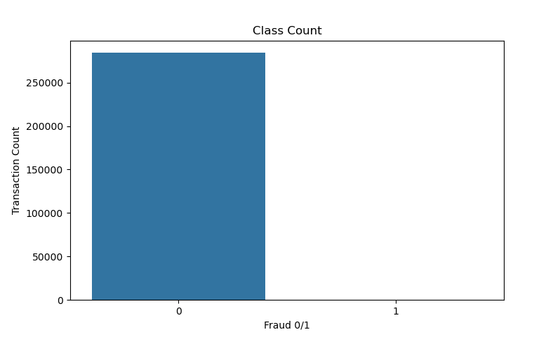
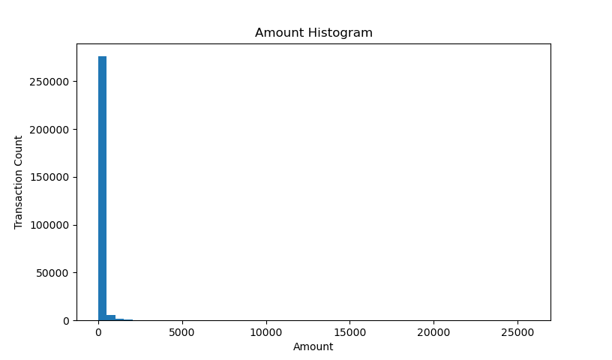
Data Exploration (1)
284315
492
Max: 25691.16
Unbalanced class (0.17% fraud):
StratifiedShuffleSplit() for train & test dataset split;
SMOTE combine with RandomUnderSampler() to increase class 1 ratio in training dataset (if necessary).
Transaction amount range is way larger than other PCA features, apply MaxMinNorm to normalize it in case the activation function get twisted.

Slide 6
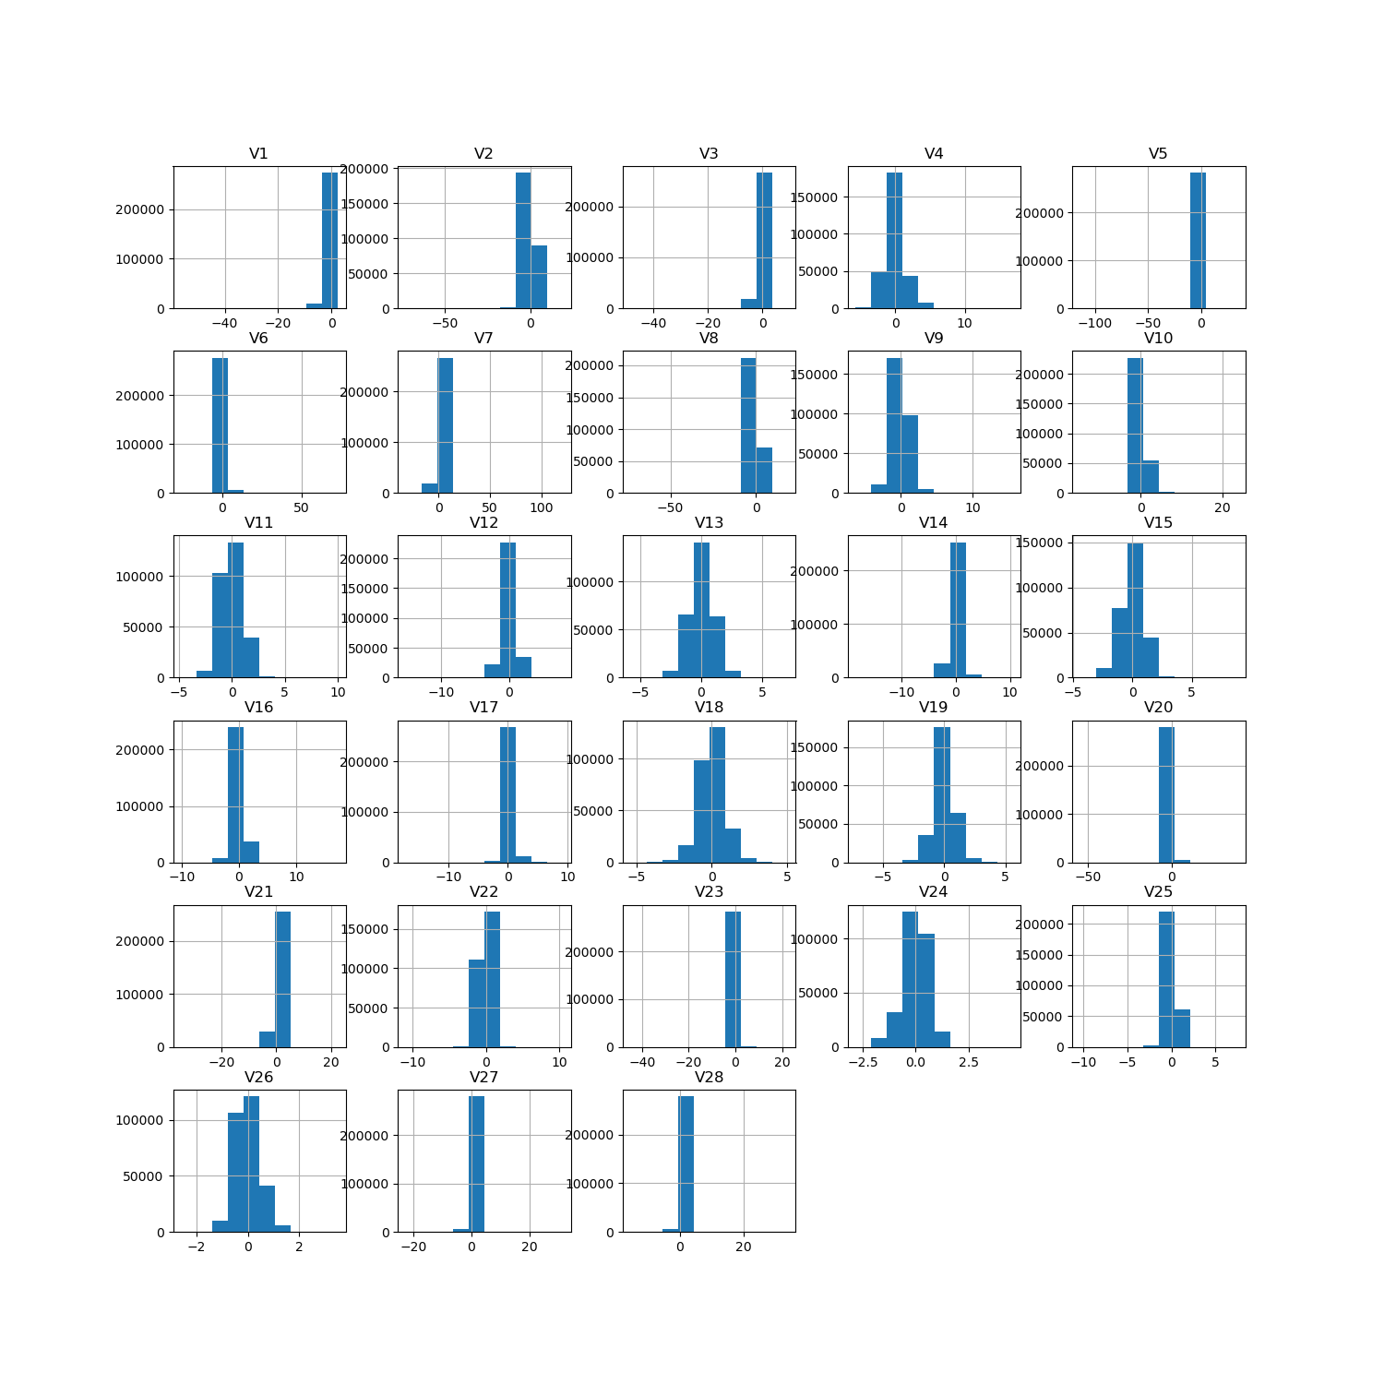
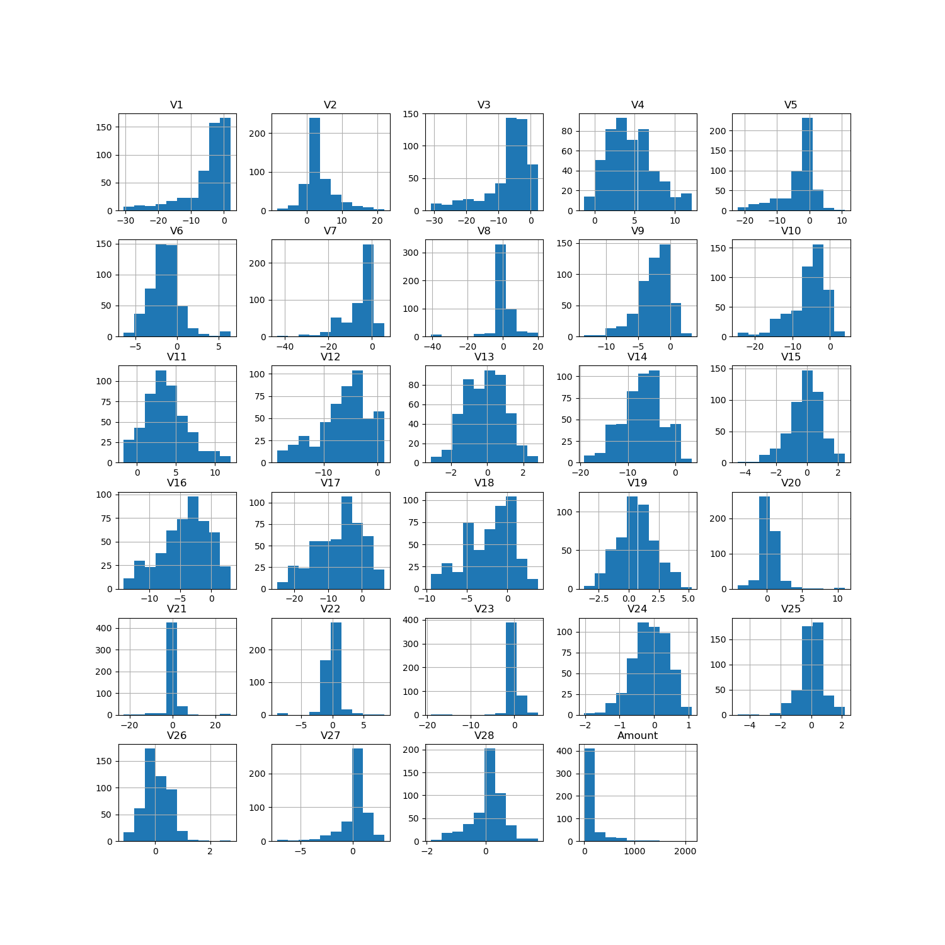
Data Exploration (2)
Normal records
Fraud records

Slide 7
Project Structure
2

Slide 8
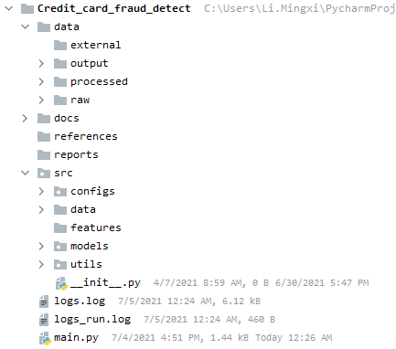
A logical and standardized project structure for doing and sharing project.
Data folder contains all the data inputs and outputs:
  Raw stores all the input dataset, which will be loaded by dataloader.py later.
  Processed stores all the data & models generated in the middle, incase we want to test code from a random point.
  Output contains the model results: data, plot, etc.
Docs contains yaml files for feature selection, the team can easily add or remove model features.
References is the folder for model knowledge.
Reports can store analysis results.
SRC is source code for use in this project: see next page
Main.py : Run the model!

Slide 9
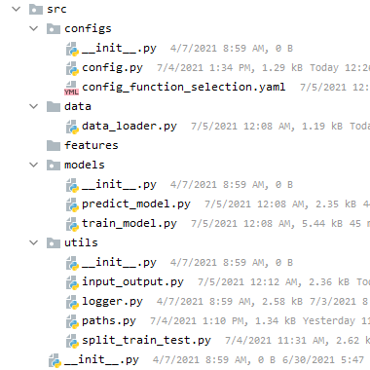
A logical and standardized project structure for doing and sharing project.
SRC is source code for use in this project:
  Configs: all the adjustable model configures are stored in yaml file and can be changed anytime by anyone. Modeling steps can also be selected and unselected.
  Data: contains scripts to turn raw data into features for modelling.
  Features: feature engineering is done here.
  Models: model training and testing.
  Utils: stores all the functional code for modeling.
    Here are data input loading & output saving format/ path. Logger will generate informations when you running code, to inform you which step the model at.

Slide 10
Training Data Prep
3

Slide 11
1. Data normalization
Only normalize ‘Amount’ column, then the data set now contains V1, V2, …, V28, Amount_norm (29 columns).
2. Splitting Train & Test (20%)
StratifiedShuffleSplit() returns stratified randomized folds. The folds are made by preserving the percentage of samples for each class.
Count | y_train | y_test
0 | 227451 | 56864
1 | 394 | 98
3. SMOTE + RandomUnderSampler
SMOTE generates the synthetic samples for the minority class, which helps to overcome the overfitting problem posed by random oversampling.
SMOTE normally combined with under sampling function to balance the class distribution.
Count | y_train | y_smote
0 | 227451 | 64985
1 | 394 | 45490

Slide 12
Model Building
4

Slide 13
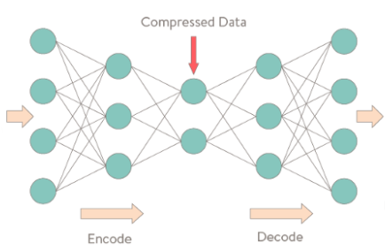
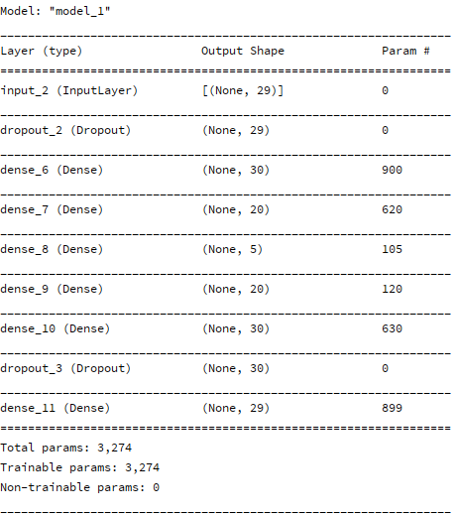
Autoencoder Model - Build
30
30
20
20
Input layer
Output layer
5
Hidden layers activation function: ReLu
Output layer’s activation function: sigmoid(x) = 1 / (1 + exp(-x))
Dropout layer: 0.1 (avoid overfitting)

Slide 14
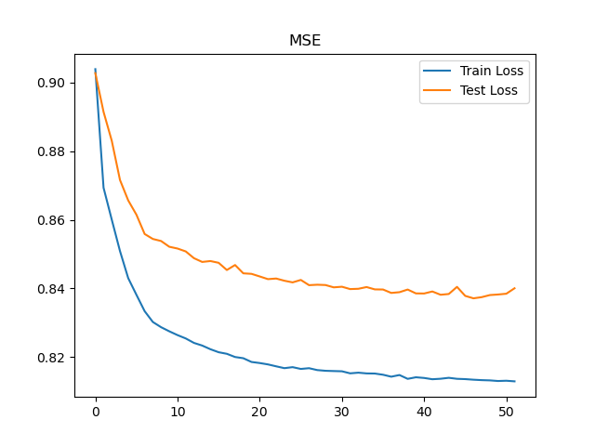
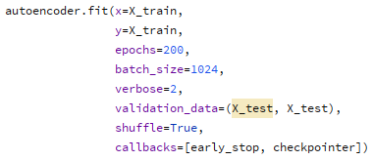
Autoencoder Model – Train
Reconstruction error (loss): MSE
Optimizer: Adam
This loss plot is without SMOTE oversampling.

Slide 15
Autoencoder Model – Threshold (1)
mean(mse)0 = 0.76
std(mse)0 = 3.14
Class=0
Threshold
predict(X_train)
mean(mse, axis=1)
Class=1
mean(mse)1= 27.36
std(mse)1 = 38.48
Trained model predicting on train data, then calculate mean MSE by each observation (row), grouping observations by 0/1 class then calculate mean MSE for each class, the mean MSE of class 0 with standard deviation can be the threshold for predicted dataset.

Slide 16
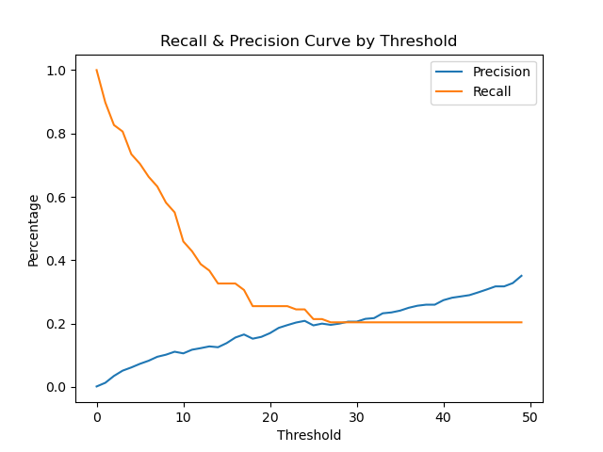
Autoencoder Model – Threshold (2)
This MSE threshold (around 27) seems in line with the fraud mean MSE value, but the predicting result is not what we want, we care more about how many fraud the model correctly caught.

Slide 17
Anomaly Detection
5

Slide 18
Autoencoder Model – Threshold = 3.9
Fraud!
> threshold
predict(X_test)
mean(mse, axis=1)
< threshold
Normal
 | Normal | Fraud
Normal | 55740 | 1124
Fraud | 25 | 73
Test
Predict

Slide 19
Discussion

Slide 20
Appendix
ReLU (Rectified Linear Unit) function: f(x) = max(0, x)
Sigmoid function: s(x) = 1/ (1+e^(-x))
Adam optimization: a stochastic gradient descent method that is based on adaptive estimation of first-order and second-order moments.
6

